Slide 1
DATA ANALYTICS BOOTCAMP | FINAL PROJECT
Olist Store Analysis
99,441
9
orders analysed
linked CSV files
Brazilian E-Commerce Data Analytics Project
5
3
Team project presentation
From raw CSV files to business decisions
business KPIs
dashboards built
Notes:
Welcome. Today we present our Olist Store Analysis, a Data Analytics Bootcamp project on a Brazilian e-commerce marketplace. We will follow one story: raw CSV files, connected data, SQL analysis, three dashboards, insights and finally business decisions. The project covers 99,441 orders across nine linked CSV files and answers five business questions.

Slide 2



What Is Olist, and Why This Project?
1
THE PROBLEM
What is Olist?
What do we analyse?
Why we chose it
A Brazilian e-commerce marketplace where sellers reach online customers. Our data covers 99,441 orders.
Payments, reviews, delivery times, products and customer cities, spread over nine linked CSV files.
Real, multi-table data is perfect for practising JOINs, SQL and dashboards, the daily work of a data analyst.
THE BUSINESS PROBLEM
When do customers pay, how fast do we deliver, and does delivery speed change how happy customers are?
Notes:
Olist is a Brazilian e-commerce marketplace. We picked it because it is realistic: many tables, real keys, real messy values. The business problem we explore is simple: when do customers pay, how fast do we deliver, and does delivery speed affect customer satisfaction. Everything that follows is built to answer this.

Slide 3





Five Business Questions We Answer
1
THE PROBLEM
KPI 1
Weekday vs weekend payments
Do customers pay more on weekdays or on weekends?
KPI 2
Five-star reviews + credit card
How many five-star orders were paid by credit card?
KPI 3
Pet Shop delivery days
How many days does a Pet Shop order take to arrive?
KPI 4
São Paulo price and payment
What do São Paulo customers pay per item and per payment?
KPI 5
Shipping days vs review score
Do slower deliveries go with lower review scores?
Notes:
These are the five business questions in our project brief: weekday versus weekend payment statistics; five-star reviews paid by credit card; average delivery days for Pet Shop products; average product price and payment value for São Paulo customers; and the relationship between shipping days and review scores. Each one needs data from more than one table, which is why we needed JOINs.

Slide 4
Dataset Overview: Nine Linked CSV Files
2
THE DATA
E-Commerce
orders
order_items
order_payments
One row per order: status and key dates
Items in each order: product, seller, price
How each order was paid: type and value
business domain
9
order_reviews
products
category translation
CSV files
Customer review score for each order
Product details, including category name
Portuguese to English category names
≈ 45 MB
zipped dataset folder
customers
sellers
geolocation
Customer ID and city
Seller ID and seller location
Zip code prefix and map coordinates
Used in our five SQL queries
Part of the relationship model
Notes:
The dataset is an e-commerce domain: nine CSV files, roughly 45 MB zipped. Each file is like a small table in a database. Orders hold dates, order items hold prices and sellers, payments hold the money, reviews hold the stars, and customers, sellers and geolocation hold where people are. Seven of these tables appear in our SQL queries; sellers and geolocation are part of the relationship model. The category translation file turns Portuguese category names into English, which we need for pet_shop.

Slide 5
How the Tables Connect
2
THE DATA
order_payments
products
+ category translation
Primary key (PK)
A column that identifies each row once, such as order_id in orders.
Foreign key (FK)
A column that points to another table’s PK, such as order_id in payments.
Why JOIN?
Orders know the dates, payments know the money, reviews know the stars. No single file can answer our KPIs, so we join them on shared keys.
order_id
product_id
customers
orders
central table
order_items
customer_id
order_id
zip_code_prefix
order_id
seller_id
geolocation
order_reviews
sellers
zip_code_prefix
Simplified relationship map, redrawn from our project keys. Dashed line: sellers also link to geolocation.
Notes:
A primary key identifies one row of a table; a foreign key is a column that points to a primary key in another table. order_id connects orders, payments and reviews. product_id connects order items to products, and the product category is translated through the category translation table. customer_id connects customers to orders. seller_id connects sellers to order items. zip_code_prefix connects customer and seller locations to the geolocation table. We use JOINs because each table holds only one piece of the story, so we cannot analyse them independently.

Slide 6
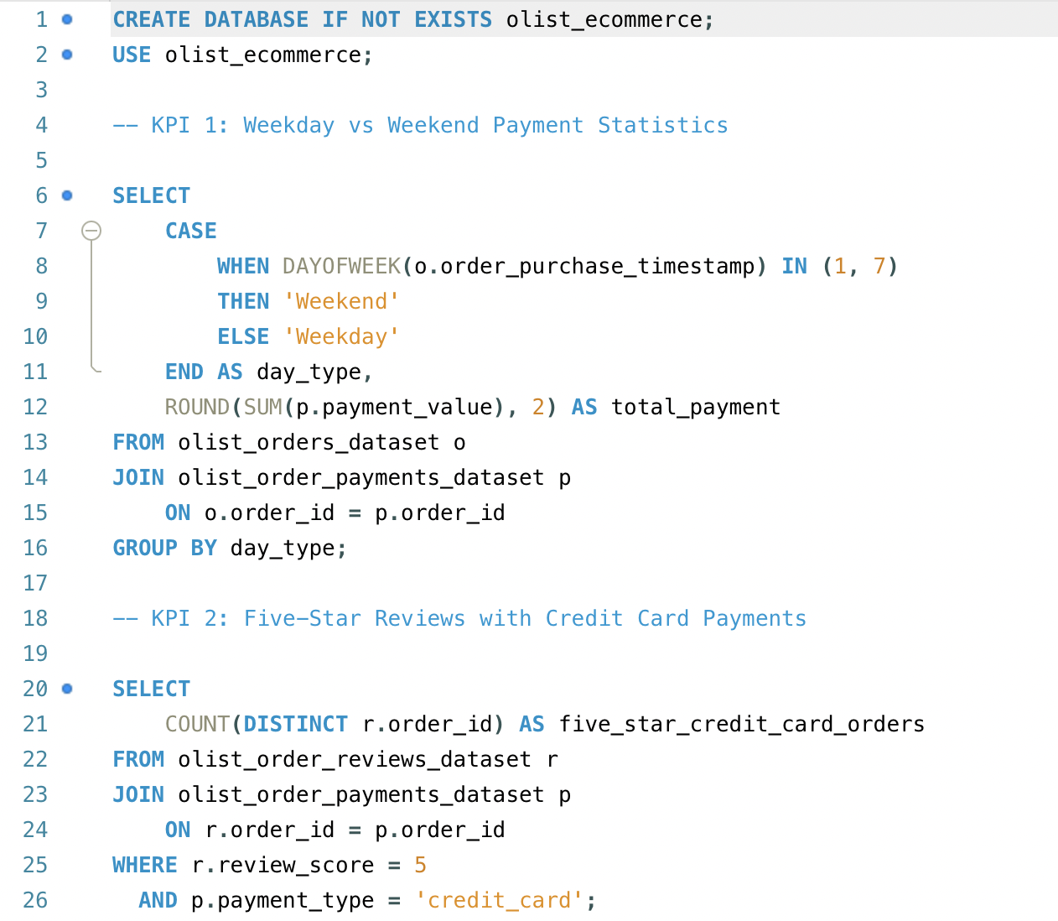
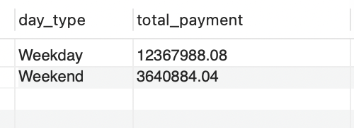
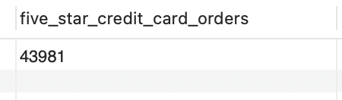
SQL Results: Payments and Five-Star Reviews
3
SQL ANALYSIS
KPI 1 · Weekday vs weekend payments
Query: CASE WHEN tags each order Weekday or Weekend; JOIN adds payments; SUM by day type.
Purpose: Compare payment value on weekdays and weekends.
Output: Weekdays hold 77.3% of payment value.
KPI 2 · Five-star reviews + credit card
Query: JOIN reviews to payments; score = 5 and credit_card; COUNT DISTINCT orders.
Purpose: Count five-star orders paid by credit card.
Output: 43,981 five-star orders paid by credit card.
Notes:
Left: our actual SQL for KPI 1 and KPI 2. KPI 1 tags each order Weekday or Weekend with CASE WHEN and DAYOFWEEK, joins orders to payments on order_id, and sums payment_value by day type. The output is 12,367,988.08 for weekdays and 3,640,884.04 for weekends, so weekdays hold about 77.3 percent of payment value. These are totals over five weekdays against two weekend days. KPI 2 joins reviews to payments, keeps five-star reviews paid by credit card, and counts distinct orders. The output is 43,981.

Slide 7
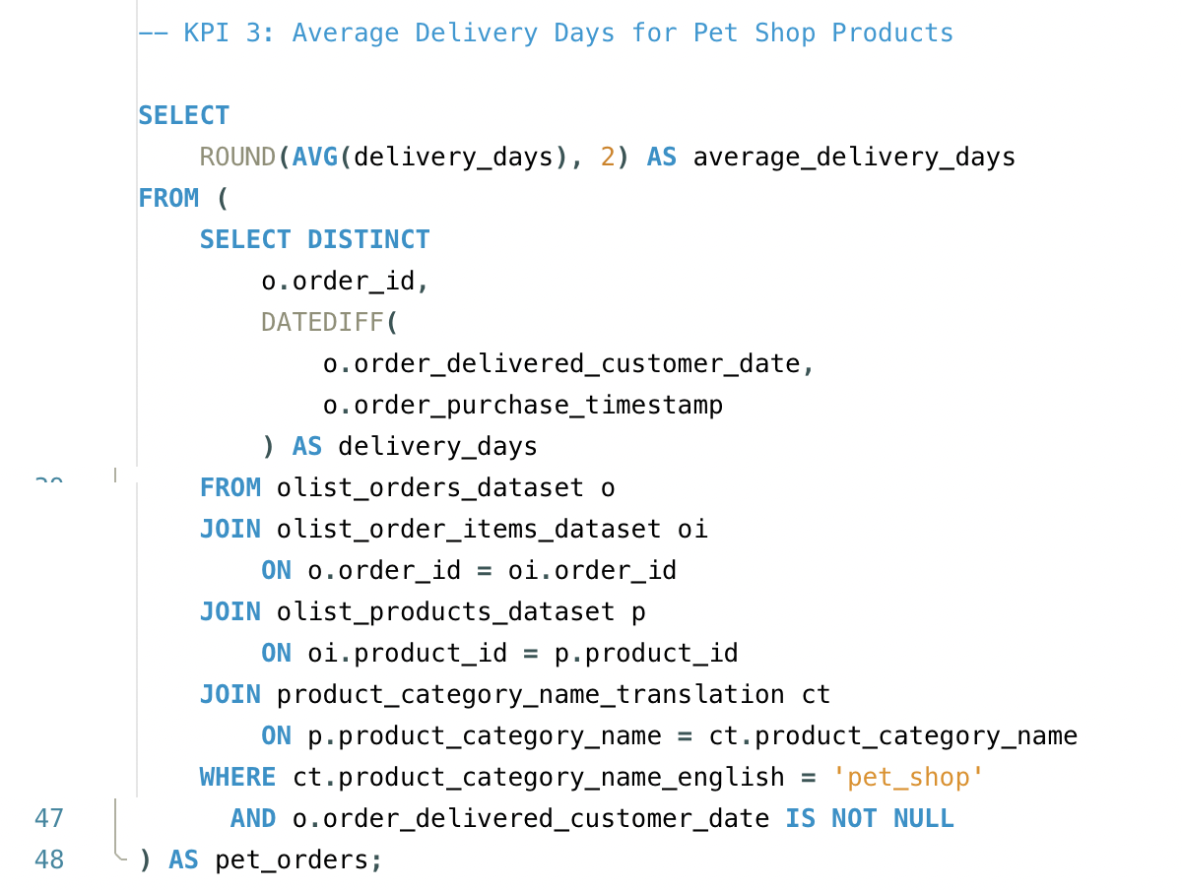
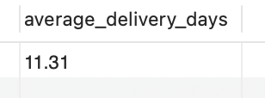
SQL Results: Pet Shop Delivery Days
3
SQL ANALYSIS
Query explanation
Inner query: one row per order with DATEDIFF(delivered, purchased).
DISTINCT and four JOINs: orders, items, products, English category names.
WHERE category is 'pet_shop' and delivery date IS NOT NULL.
Outer query: ROUND(AVG(delivery_days), 2).
Purpose: Find how many days a Pet Shop order takes to reach the customer.
Output: average Pet Shop delivery is 11.31 days.
Notes:
KPI 3 uses a subquery. The inner query builds one row per Pet Shop order with delivery_days from DATEDIFF; the four JOINs are needed because the category name sits in products and the English name in the translation table. The outer query averages and rounds. The output is 11.31 days. Our dashboards show 11.4, 11.37 and 10.91, so they should be reconciled against this SQL definition.

Slide 8
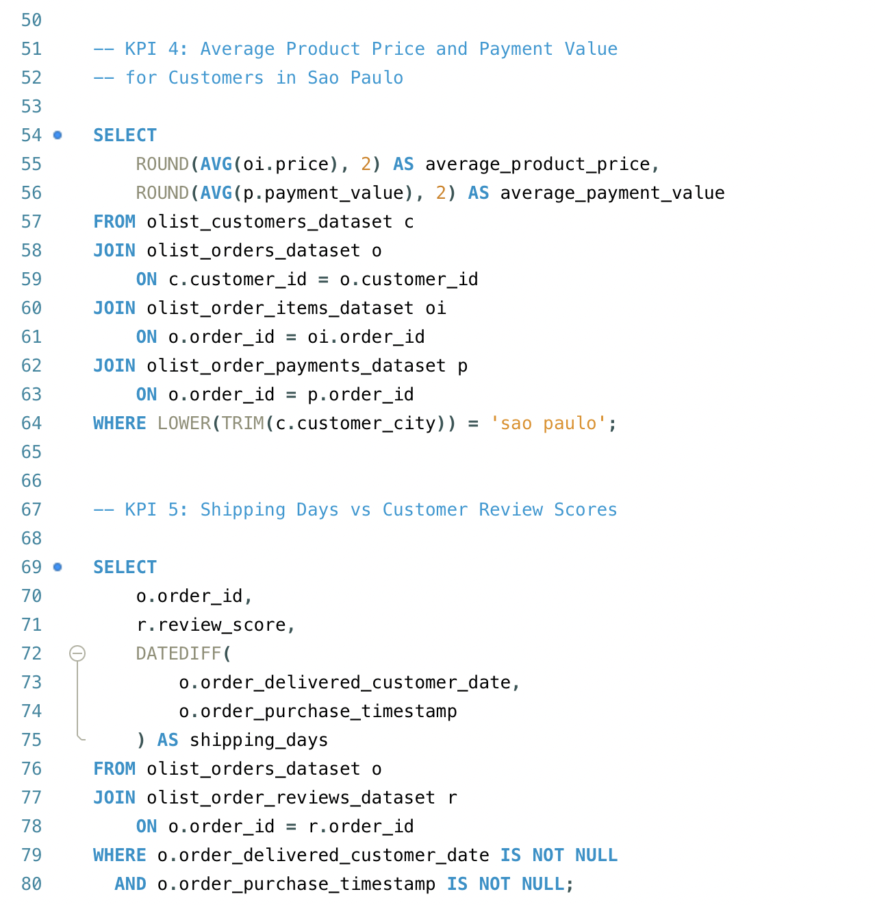
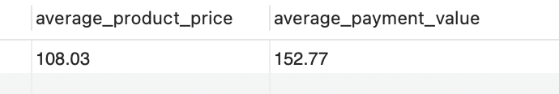
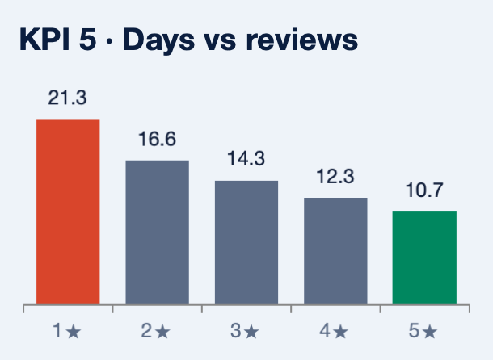
SQL Results: São Paulo and Review Scores
3
SQL ANALYSIS
KPI 4 · São Paulo price and payment
Query: JOIN customers, orders, items, payments; city = 'sao paulo'; AVG of price and payment_value.
Purpose: Measure what São Paulo customers pay.
Output: avg price R$108.03, avg payment R$152.77.
KPI 5 · Shipping days vs review score
Query: One row per order: score and shipping days.
Purpose: Do slower deliveries get lower scores?
Output: 21.3 days (1★) to 10.7 days (5★), r = −0.33.
Notes:
KPI 4 joins customers, orders, items and payments, filters São Paulo with LOWER(TRIM(city)), and averages price and payment_value. The output is R$108.03 average item price and R$152.77 average payment. Because items and payments both join on order_id, rows can repeat, so treat the averages with care. KPI 5 returns one row per order with its review score and shipping days; averaging by score gives 21.3 days for one-star orders down to 10.7 days for five-star orders, with a correlation of minus 0.33. That is correlation, not proof of cause.

Slide 9
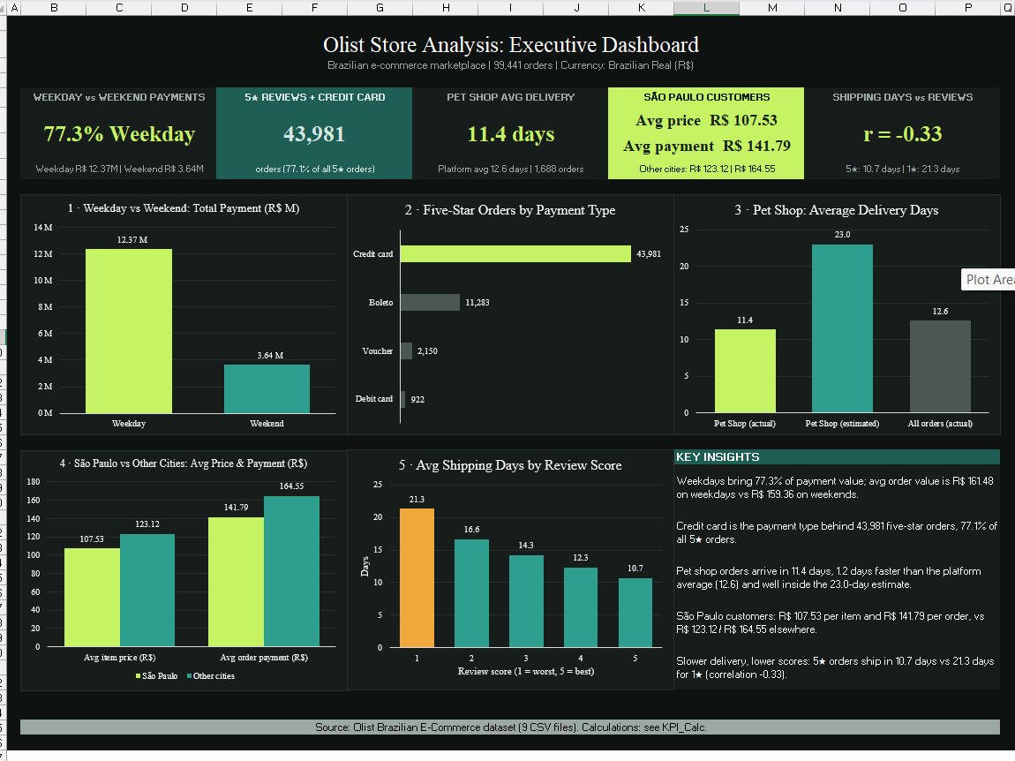
Excel Dashboard: The Executive Summary
4
DASHBOARDS
KPI CARDS
Five cards on top: 77.3% weekday, 43,981 five-star card orders, 11.4 days, São Paulo R$107.53 / R$141.79, r = −0.33.
CHARTS
One chart per KPI with data labels, plus a Key Insights box. Header: 99,441 orders.
INSIGHT
Weekday order value is R$161.48 vs R$159.36 on weekends: weekdays win on volume, not bigger orders.
Calculations sit on a KPI_Calc sheet, so every number can be traced.
Notes:
This is our Excel executive dashboard. Five KPI cards sit at the top, one per business question, followed by five charts and a Key Insights panel. It shows 77.3 percent of payment value on weekdays, 43,981 five-star credit card orders, 11.4 days for Pet Shop delivery, São Paulo average price R$107.53 and payment R$141.79, and a correlation of minus 0.33 between shipping days and review score. Excel is excellent for a clean one-page summary, and the footer points to a KPI_Calc sheet for the calculations.

Slide 10
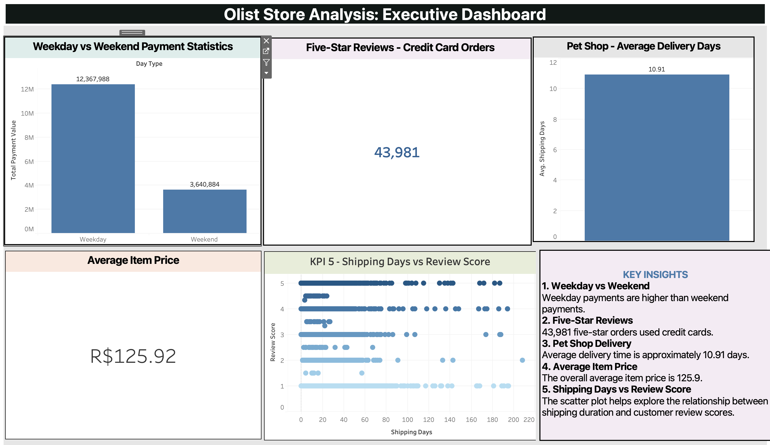
Tableau Dashboard: Exploring the Detail
4
DASHBOARDS
KPI CARDS AND CHARTS
Weekday R$12,367,988 vs weekend R$3,640,884; 43,981 card orders; Pet Shop 10.91 days; item price R$125.92.
INTERACTIVITY
Each sheet has a hover toolbar (filter, expand) so viewers can explore.
SCATTER PLOT
Each dot is an order: review score vs shipping days, from 0 to 200+ days.
Tableau shows Pet Shop at 10.91 days and an overall Average Item Price of R$125.92, so it does not match Excel yet.
Notes:
Our Tableau dashboard uses the same five KPIs. Bar charts show weekday and weekend payment totals, 12,367,988 against 3,640,884. The cards show 43,981 five-star credit card orders and an average item price of R$125.92, which is across all customers, not only São Paulo. Pet Shop delivery shows 10.91 days, different from Excel. The scatter plot shows every order as a dot, review score against shipping days. Long waits occur at every score, so the trend is easier to see in the averaged views in Excel and Power BI. The screenshot shows a hover toolbar with filter and expand options on each sheet.

Slide 11
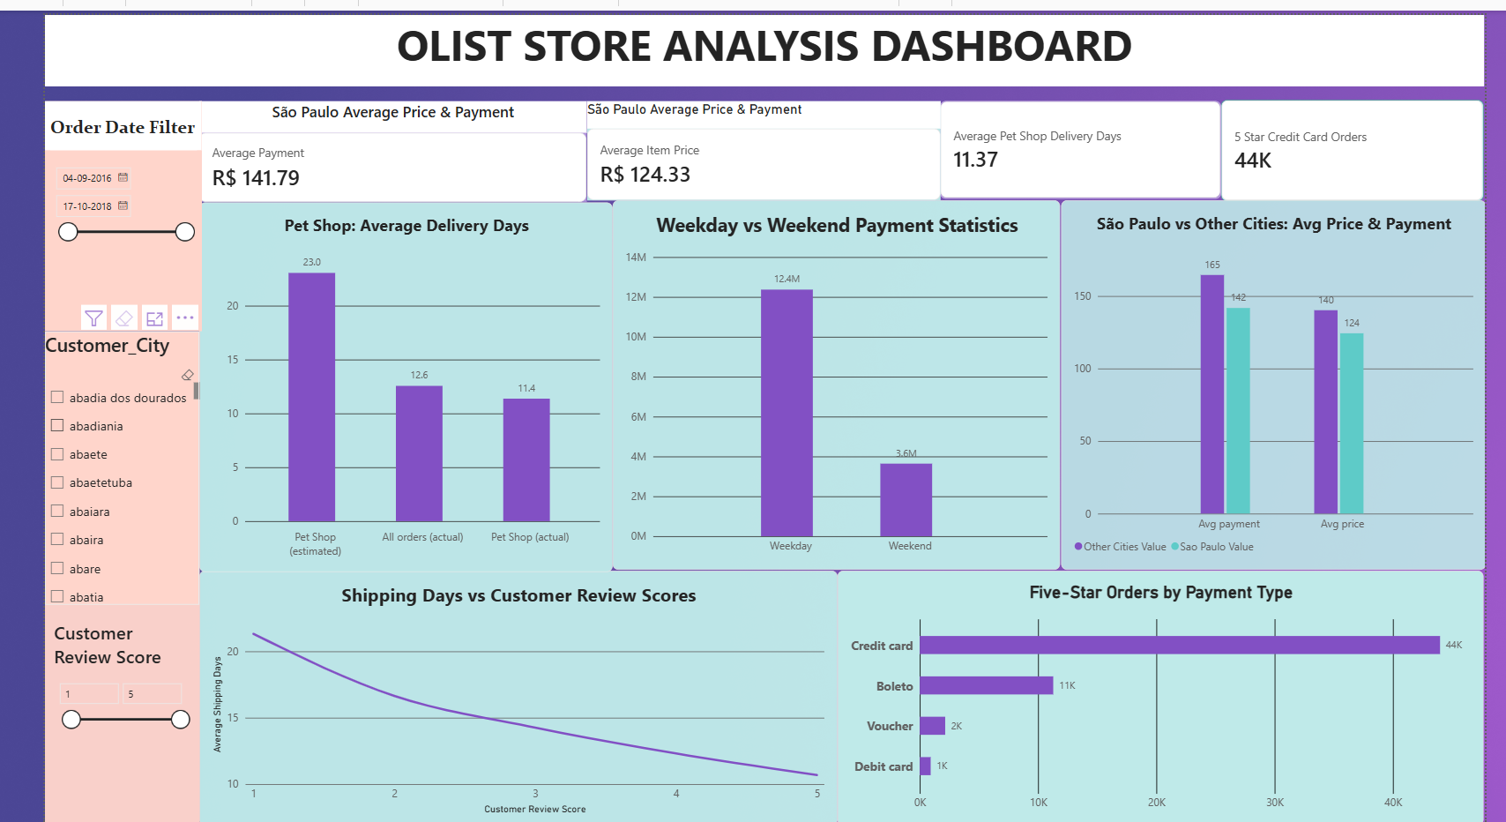
Power BI Dashboard: Interactive Slicers
4
DASHBOARDS
SLICERS
Order date (04-09-2016 to 17-10-2018), Customer_City list and Review Score 1 to 5.
KPI CARDS
Avg payment R$141.79, avg item price R$124.33, Pet Shop 11.37 days, 44K five-star card orders.
VISUALS
Delivery days falls from about 21 (1★) to 11 (5★). Credit card leads five-star orders.
KPI 5 appears here as a line chart of average shipping days by score. The scatter plot is in the Tableau view.
Notes:
The Power BI dashboard is the most interactive. On the left are slicers for order date, customer city and review score. KPI cards show average payment R$141.79, average item price R$124.33, Pet Shop delivery of 11.37 days and 44K five-star credit card orders, which is 43,981 rounded. Charts compare Pet Shop delivery, weekday against weekend, São Paulo against other cities, payment types for five-star orders, and shipping days by review score. Note the shipping days versus review chart here is a line chart, and the scatter plot is in Tableau. Also note the date slicer: a filter like this can change KPI values if the other dashboards do not use the same range.

Slide 12
Excel vs Tableau vs Power BI
4
DASHBOARDS
Excel
Tableau
Power BI
Helped us: build a one-page executive summary with KPI cards and a Key Insights box.
Look: dark theme, five clear charts.
Interactivity: lowest. No slicers visible, a fixed view.
Helped us: see every order in a scatter plot, not only averages.
Look: clean cards and bars.
Interactivity: medium. Hover toolbar to filter and explore.
Helped us: let managers slice by date, city and review score.
Look: five charts, including São Paulo vs other cities.
Interactivity: highest. Three slicers on the page.
Why use more than one tool? Different audiences need different views, and comparing them exposed KPI mismatches we would have missed in one tool.
Notes:
Excel gave us a clean, formula-traceable executive summary. Tableau helped us explore order-level detail with a scatter plot. Power BI gave managers slicers for date, city and review score. They show the same business data in different ways: Excel is a fixed summary, Tableau is exploratory, Power BI is the most interactive. Using several tools also helped us spot inconsistencies between them, which we cover on the mistakes slide.

Slide 13
What the Data Reveals
5
INSIGHTS
77.3%
43,981
≈ 11 days
of payment value on weekdays
five-star orders paid by credit card
Pet Shop delivery
R$12.37M vs R$3.64M. Per order they are similar: R$161.48 vs R$159.36.
77.1% of all five-star orders. Boleto is next with 11,283.
11.4 (Excel), 11.37 (Power BI), 10.91 (Tableau). Needs reconciling.
R$107.53
r = −0.33
avg item price, São Paulo (Excel)
shipping days vs review score
Avg payment R$141.79. Other cities: R$123.12 and R$164.55. Not comparable with R$125.92 (all customers, Tableau).
5★ orders arrive in 10.7 days, 1★ in 21.3. Slower delivery goes with lower scores: a link, not proof of cause.
Notes:
Five insights. One: weekdays hold 77.3 percent of payment value, but weekdays are five days of the week and the average order value is almost the same. Two: credit cards account for 43,981 five-star orders. Three: Pet Shop delivery is about 11 days, but dashboards show 11.4, 11.37 and 10.91, so we need to reconcile. Four: São Paulo customers show R$107.53 average item price and R$141.79 average payment in Excel, lower than other cities; we should not compare this with R$125.92, which is the all-customer average in Tableau. Five: faster delivery goes with better reviews, with a correlation of minus 0.33. That is a moderate negative association, not proof that delivery speed causes review scores.

Slide 14




From Insight to Business Decision
6
DECISIONS
Improve delivery operations
Monitor seller and courier performance
Improve customer satisfaction
Reviews drop from 10.7 to 21.3 days. Fix the slowest orders first.
Track delivery days by seller_id and by carrier where data exists. Flag outliers.
Send delivery updates early on slow orders, since low scores go with long waits.
Plan payment support
Analyse city-level behaviour
Find operational improvements
77.3% of value lands on weekdays and cards lead five-star orders. Staff and test for that.
São Paulo spends less per item than other cities. Use the city slicer to compare.
Reconcile KPI definitions, then track the same five KPIs every month.
How management uses the dashboards: monitor KPIs, filter by date, city and score, act, then re-measure.
Notes:
What can an e-commerce company do with this? Improve delivery operations by focusing on the slowest orders. Monitor seller performance through seller_id, and courier performance if carrier data is available. Improve customer satisfaction with proactive updates on late orders. Plan payment support around weekday volume and credit card use. Analyse city-level behaviour with the city slicer. Management can use the dashboards as a routine: monitor the KPIs, filter to find where the problem is, take action, and measure again. These are recommendations from patterns in the data, and we should test them before large decisions.

Slide 15
Challenges Faced
6
REFLECTION
Challenge: Importing CSV Data into MySQL
Problem: the MySQL Import Data Wizard was not working, so we could not load our CSV files.
LOAD DATA LOCAL INFILE 'file_path'
INTO TABLE olist_order_payments_dataset
FIELDS TERMINATED BY ','
OPTIONALLY ENCLOSED BY '"'
LINES TERMINATED BY '\n'
IGNORE 1 ROWS;
What the command does
LOAD DATA LOCAL INFILE reads the CSV file straight into a table.
FIELDS TERMINATED BY ',' splits each line into columns.
OPTIONALLY ENCLOSED BY '"' keeps quoted text together.
LINES TERMINATED BY '\n' treats each line as one row.
IGNORE 1 ROWS skips the header line.
How it helped: it bypassed the wizard, so each CSV loaded directly into its table.
Notes:
One real challenge: the MySQL Import Data Wizard was not working for our CSV files. We solved it with the LOAD DATA LOCAL INFILE command, which reads a CSV file directly into a table. FIELDS TERMINATED BY a comma splits columns, OPTIONALLY ENCLOSED BY double quotes keeps quoted text together, LINES TERMINATED BY a newline marks each row, and IGNORE 1 ROWS skips the header. The example loads the payments file into olist_order_payments_dataset; the same pattern works for the other tables.

Slide 16





The Story: From CSV to Decisions
7
CONCLUSION
Raw CSV files
Data connections
SQL analysis
Dashboards
Insights
Business decisions
9 files, 99,441 orders
Keys link orders, payments, reviews, items
Five KPI queries
Excel, Tableau, Power BI
Weekday value, card reviews, delivery link
Faster delivery, seller checks, payment support
What we learned
Weekdays carry 77.3% of payment value; credit cards lead five-star orders.
Faster delivery goes with better reviews (r = −0.33): a link to act on, not proof of cause.
Notes:
To summarise our story: we started with nine raw CSV files, connected them using keys, analysed them with five SQL queries, built dashboards in Excel, Tableau and Power BI, found insights about payments, delivery and reviews, and turned them into business decisions.

Slide 17
Team Members
7
TEAM
AS
Anne Saadhuri
asaadhuri@gmail.com
Thank you
MR
Malepati Rajitha
malepatirajitha8@gmail.com
Questions?
JD
Jeeban Jyoti Das
jeebanjyotidas2003@gmail.com
SP
Sasmita Panigrahi
Olist Store Analysis
Data Analytics Bootcamp
sasmitapanigrahi026@gmail.com
BK
Bathala Siva Kumar
shivakumar4p1@gmail.com
Notes:
Our team: Anne Saadhuri, Malepati Rajitha, Jeeban Jyoti Das, Sasmita Panigrahi and Bathala Siva Kumar. Thank you for listening. We are happy to take questions on the SQL queries, the dashboards or the business recommendations.

